Slide 1
Web Traffic Correlations
January 2017

Slide 2
Contents
Executive Summary
Box Office Gross
TV Viewership
Video Game Sales

Slide 3
Executive Summary
To demonstrate that Wikipedia pageviews are a valuable proxy for popularity, we show pageviews are a predictive indicator for various offline behaviors
Wikipedia pageviews are strong predictors of domestic box office gross
Wikipedia pageviews are strong predictors of TV viewership (when accounting for network, air-time effects)
Wikipedia pageviews are strong predictors of global video game sales

Slide 4
Contents
Executive Summary
Box Office Gross
TV Viewership
Video Game Sales

Slide 5
Box Office Gross: Methodology
Domestic Box Office Data
170 US-produced films released between January 2016 and October 2017
Filter out any films with gross less than $5 million
Wikipedia Data
Extract total “desktop” pageview count for each movie 45 days before release up to 10 days after release
Use “Page Move” tool to automatically identify Wikipedia page moves and concatenate data
Apply standard inflation correction using “color” approach
Filter out movies with less than 1000 pageviews per day at 30 days-before-release mark

Slide 6
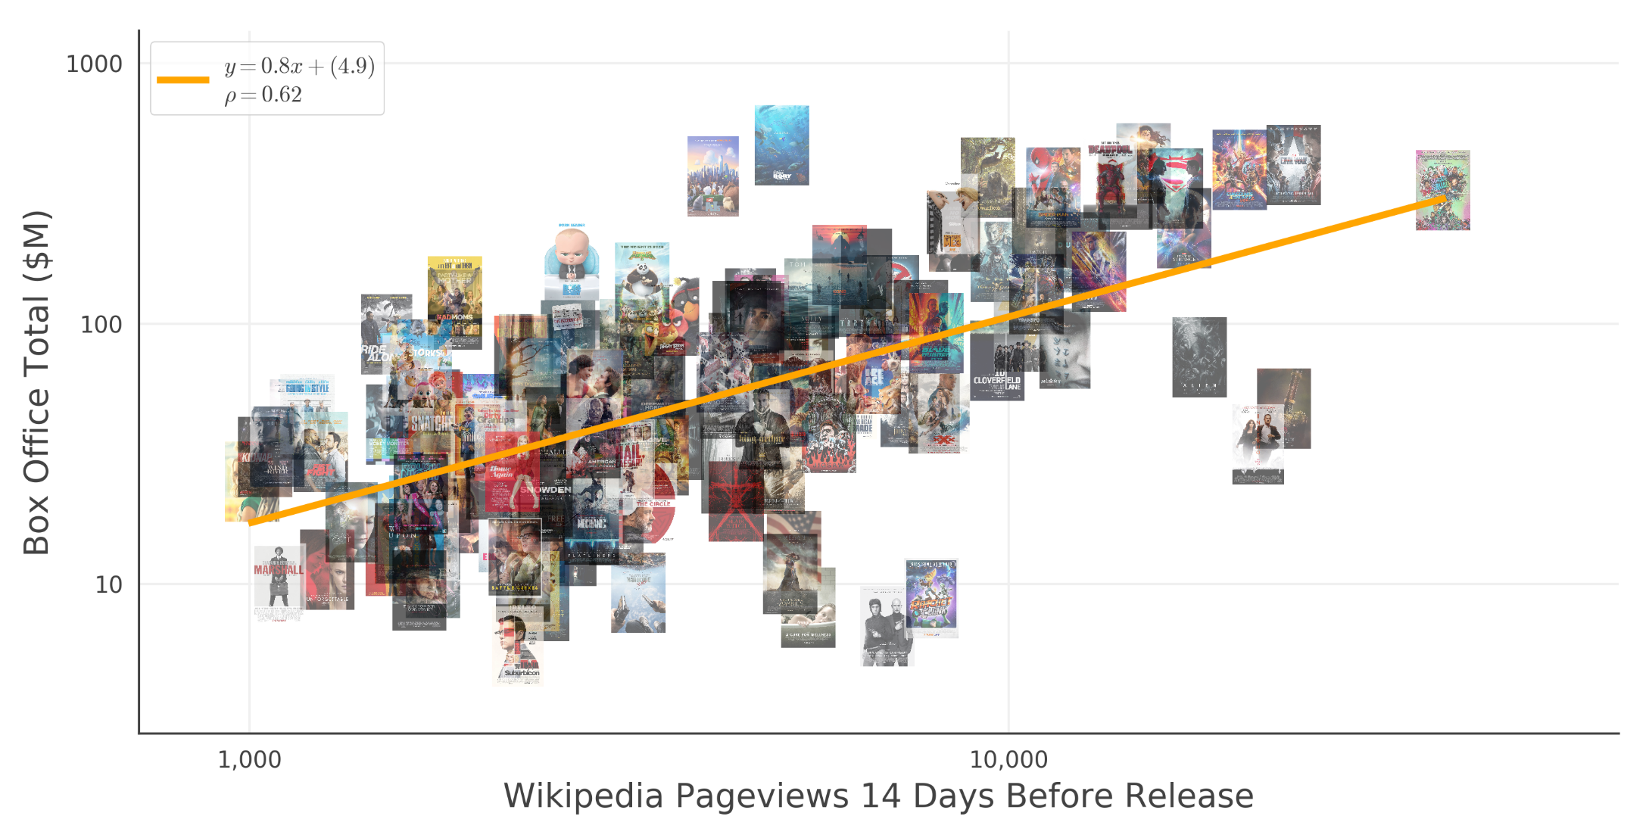
Box Office Gross
Wikipedia pageviews correlate strongly with domestic box office gross

Slide 7
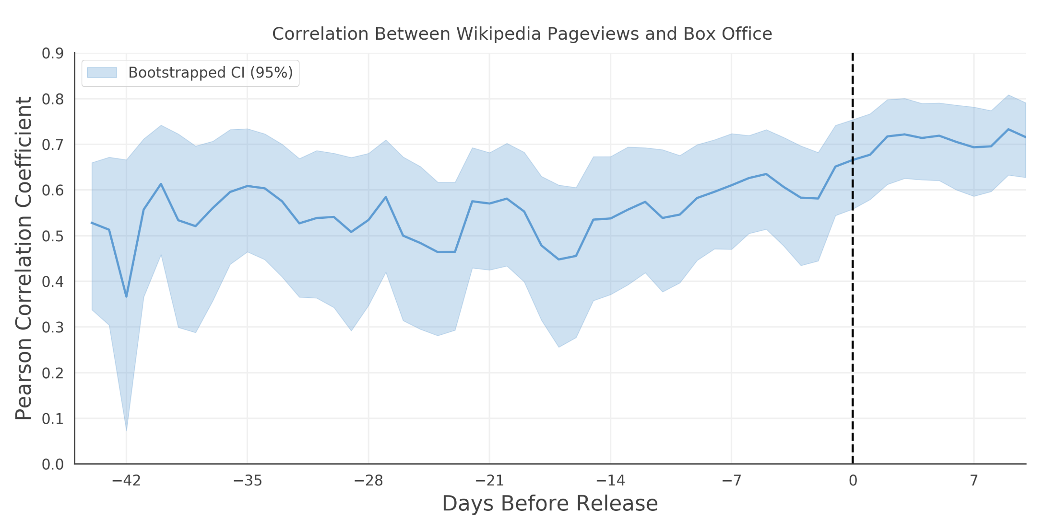
Box Office Gross
*Note: Coefficient range is from -1 (strongest negative correlation) to 1 (strongest positive correlation)
Correlation between Wikipedia pageviews and box office gross remains stable throughout pre-release window

Slide 8
Contents
Executive Summary
Box Office Gross
TV Viewership
Video Game Sales

Slide 9
TV Viewership: Methodology
Viewership Data
74 distinct television programs airing across 20 networks between January 2016 and July 2017
Episode level data includes Nielsen Viewers, Nielsen Demo*, and IMDB User Rating*
Wikipedia Data
Extract total “desktop” pageview count for each episode 3 days before the episode airs
Use “Page Move” tool to automatically identify Wikipedia page moves and concatenate data
Apply standard inflation correction using “color” approach
* Note: See Appendix

Slide 10
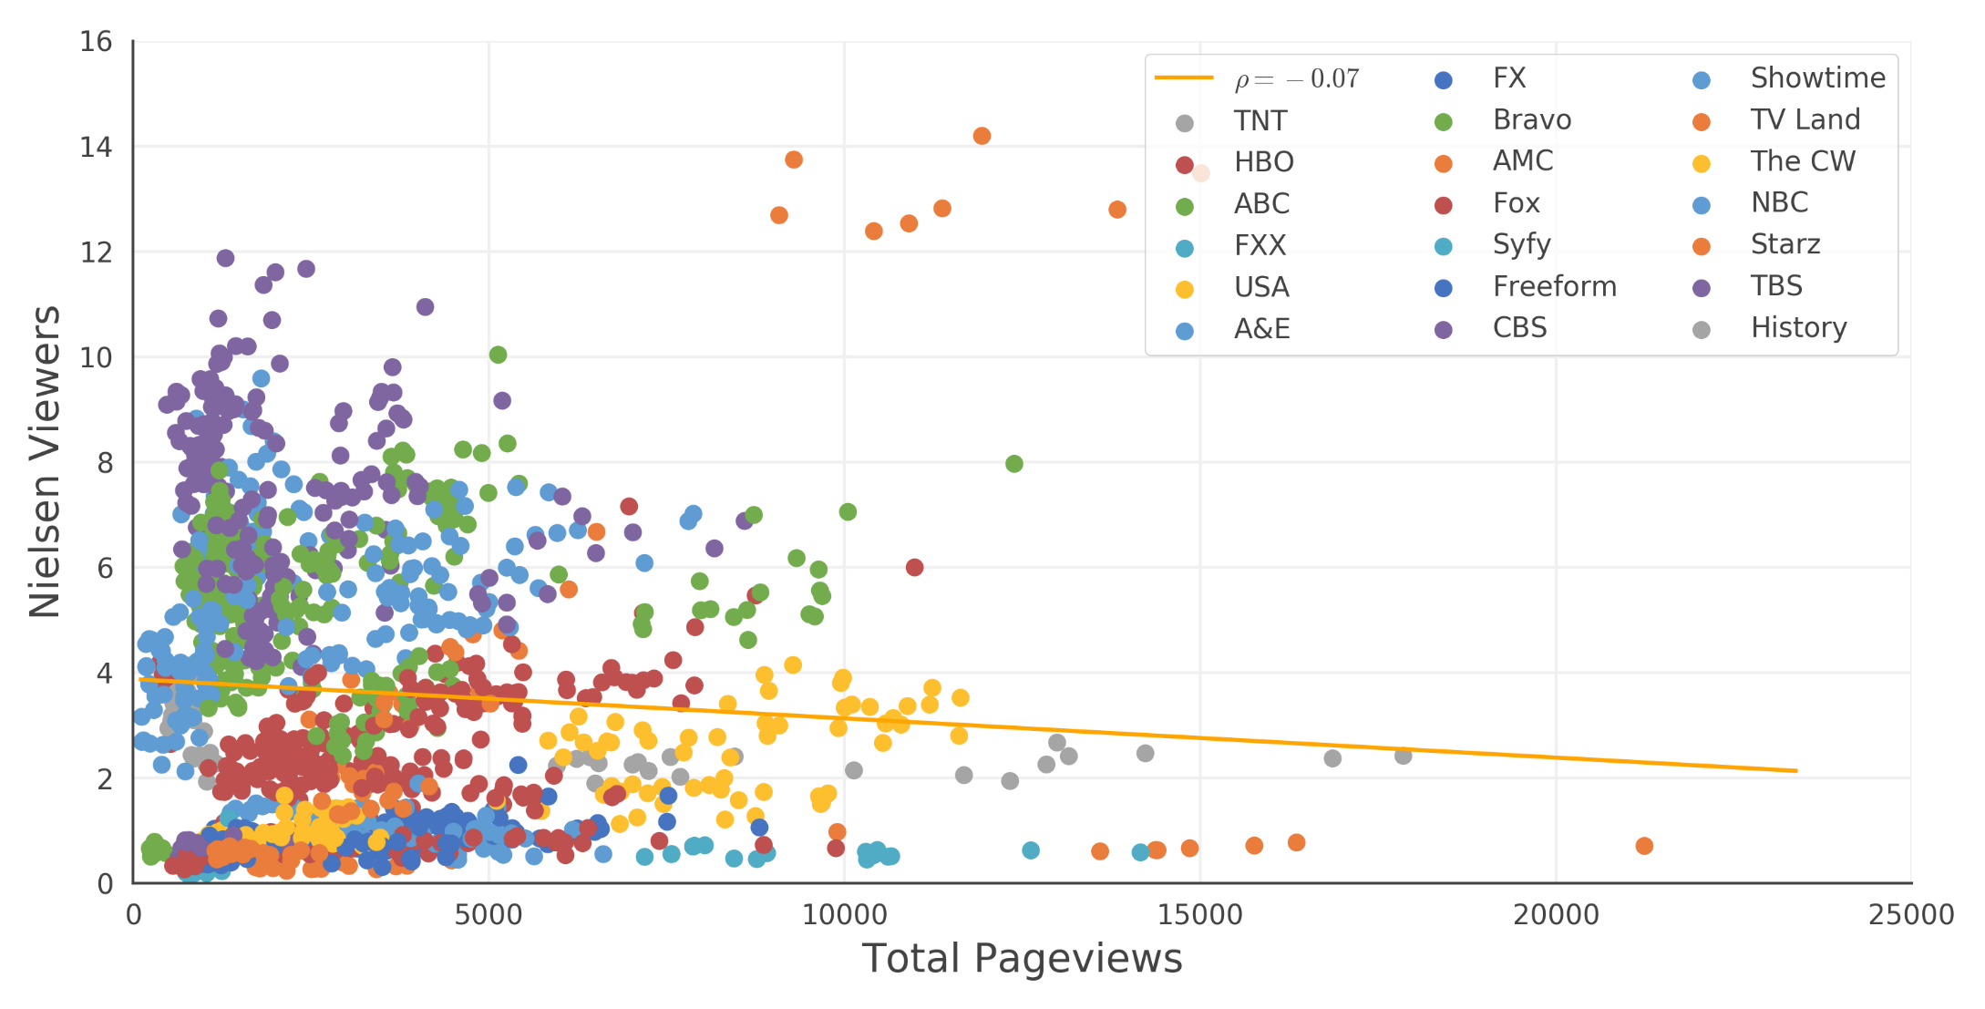
TV Viewership: Nielsen Viewer Score
*Note: Each scatter point represents 1 episode
*Note: Pageviews extracted 3-days before air date
Network and air-time effects mediate general relationship between pageviews and viewership

Slide 11
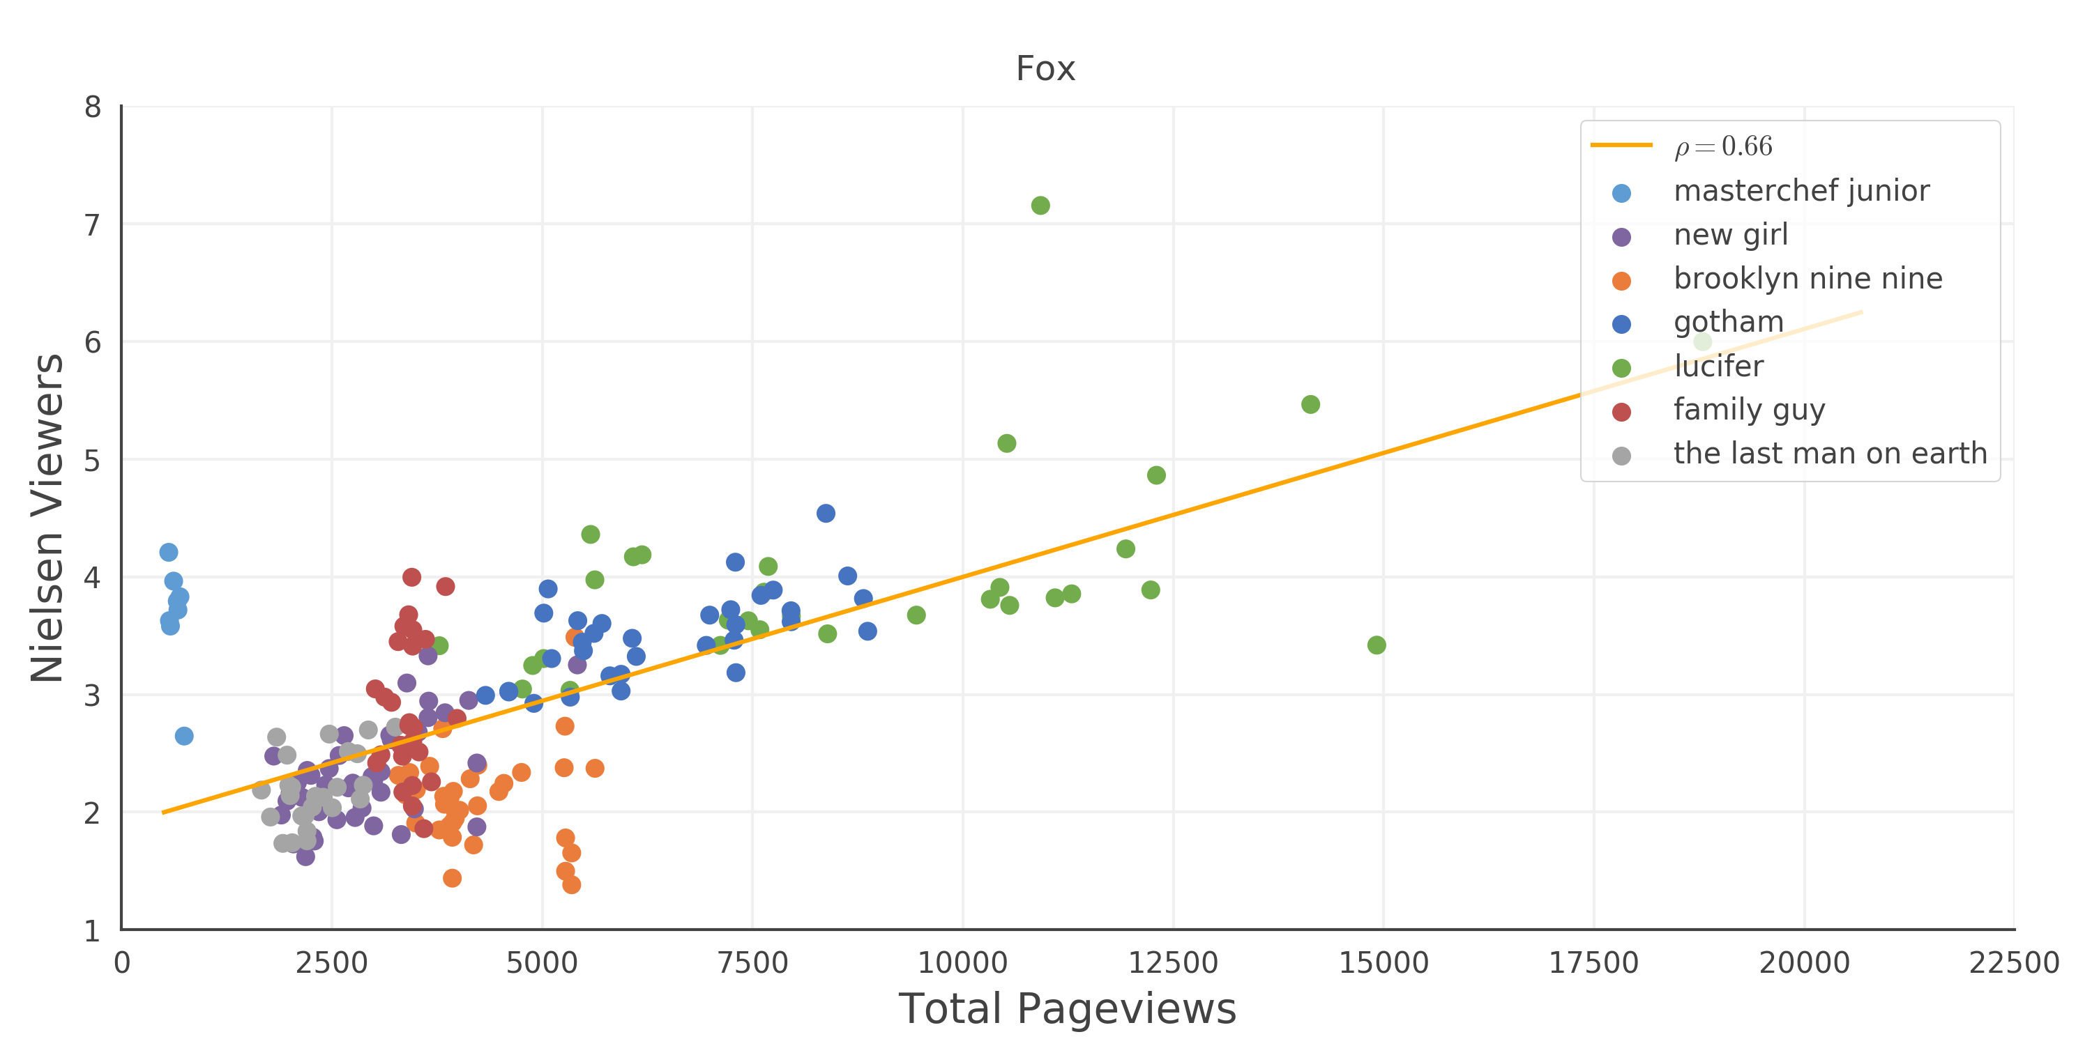
TV Viewership: Nielsen Viewer Score
*Note: Each scatter point represents 1 episode
*Note: Pageviews extracted 3-days before air date
Wikipedia pageviews for shows airing on “Fox” are predictive of viewership

Slide 12
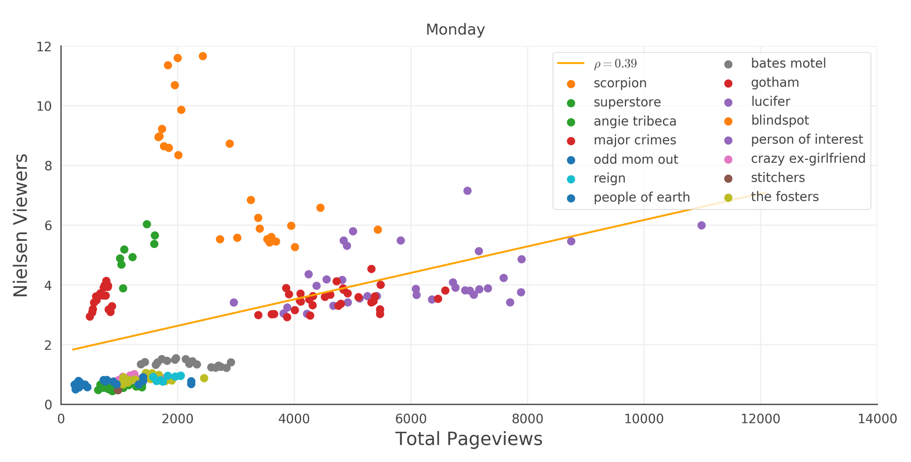
TV Viewership: Nielsen Viewer Score
*Note: Each scatter point represents 1 episode
*Note: Pageviews extracted 3-days before air date
Wikipedia pageviews are moderately predictive of viewership for shows airing on Mondays

Slide 13
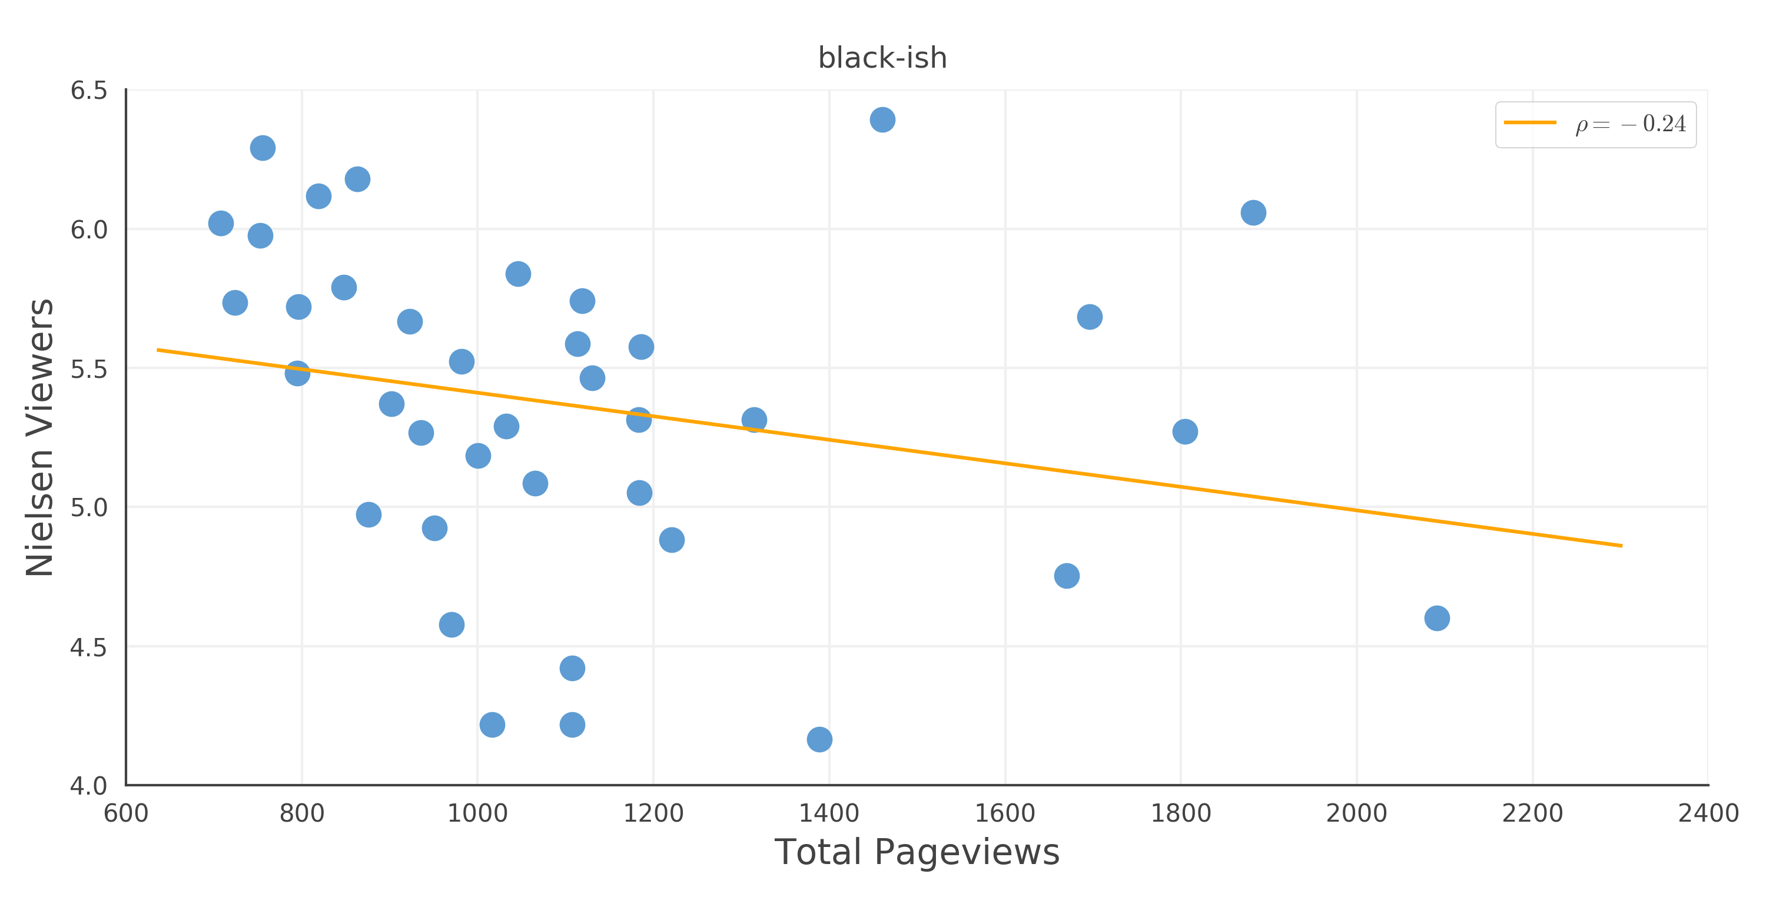
TV Viewership: Nielsen Viewer Score
*Note: Each scatter point represents 1 episode
*Note: Pageviews extracted 3-days before air date
Wikipedia pageviews for “Black-ish” do not correlate with viewership

Slide 14
Contents
Executive Summary
Box Office Gross
TV Viewership
Video Game Sales

Slide 15
Video Game Sales: Methodology
Video Game Sales Data
89 video games released on Xbox One, PlayStation 4, or Wii U during 2016
Reporting current as of December 22, 2016*
Wikipedia Data
Extract total “desktop” pageview count for each game for the entirety of 2016
Use “Page Move” tool to automatically identify Wikipedia page moves and concatenate data
Apply standard inflation correction using “color” approach
* Source: https://www.kaggle.com/rush4ratio/video-game-sales-with-ratings/data

Slide 16
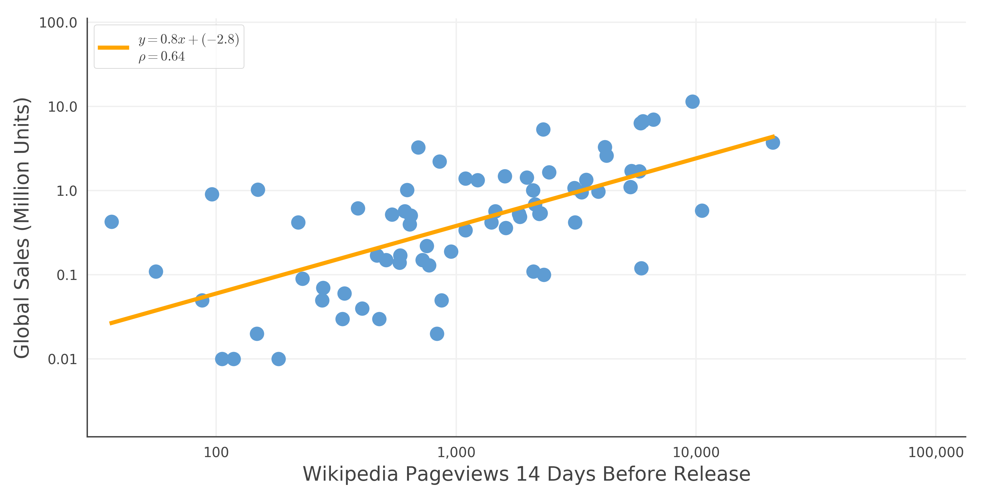
Video Game Sales
Battlefield 1
FIFA 17
Uncharted 4
Madden NFL 17
Far Cry Primal
Mafia 3
Overwatch
Dragon Ball: Xenoverse
Just Dance 2017
NHL 17
Quantum Break
RIGS: Mechanized Combat League
Worms: WMD
Rise of the Tomb Raider
*Note: Annotations are done randomly
Pre-release Wikipedia pageviews are a strong indicator of global video game sales

Slide 17
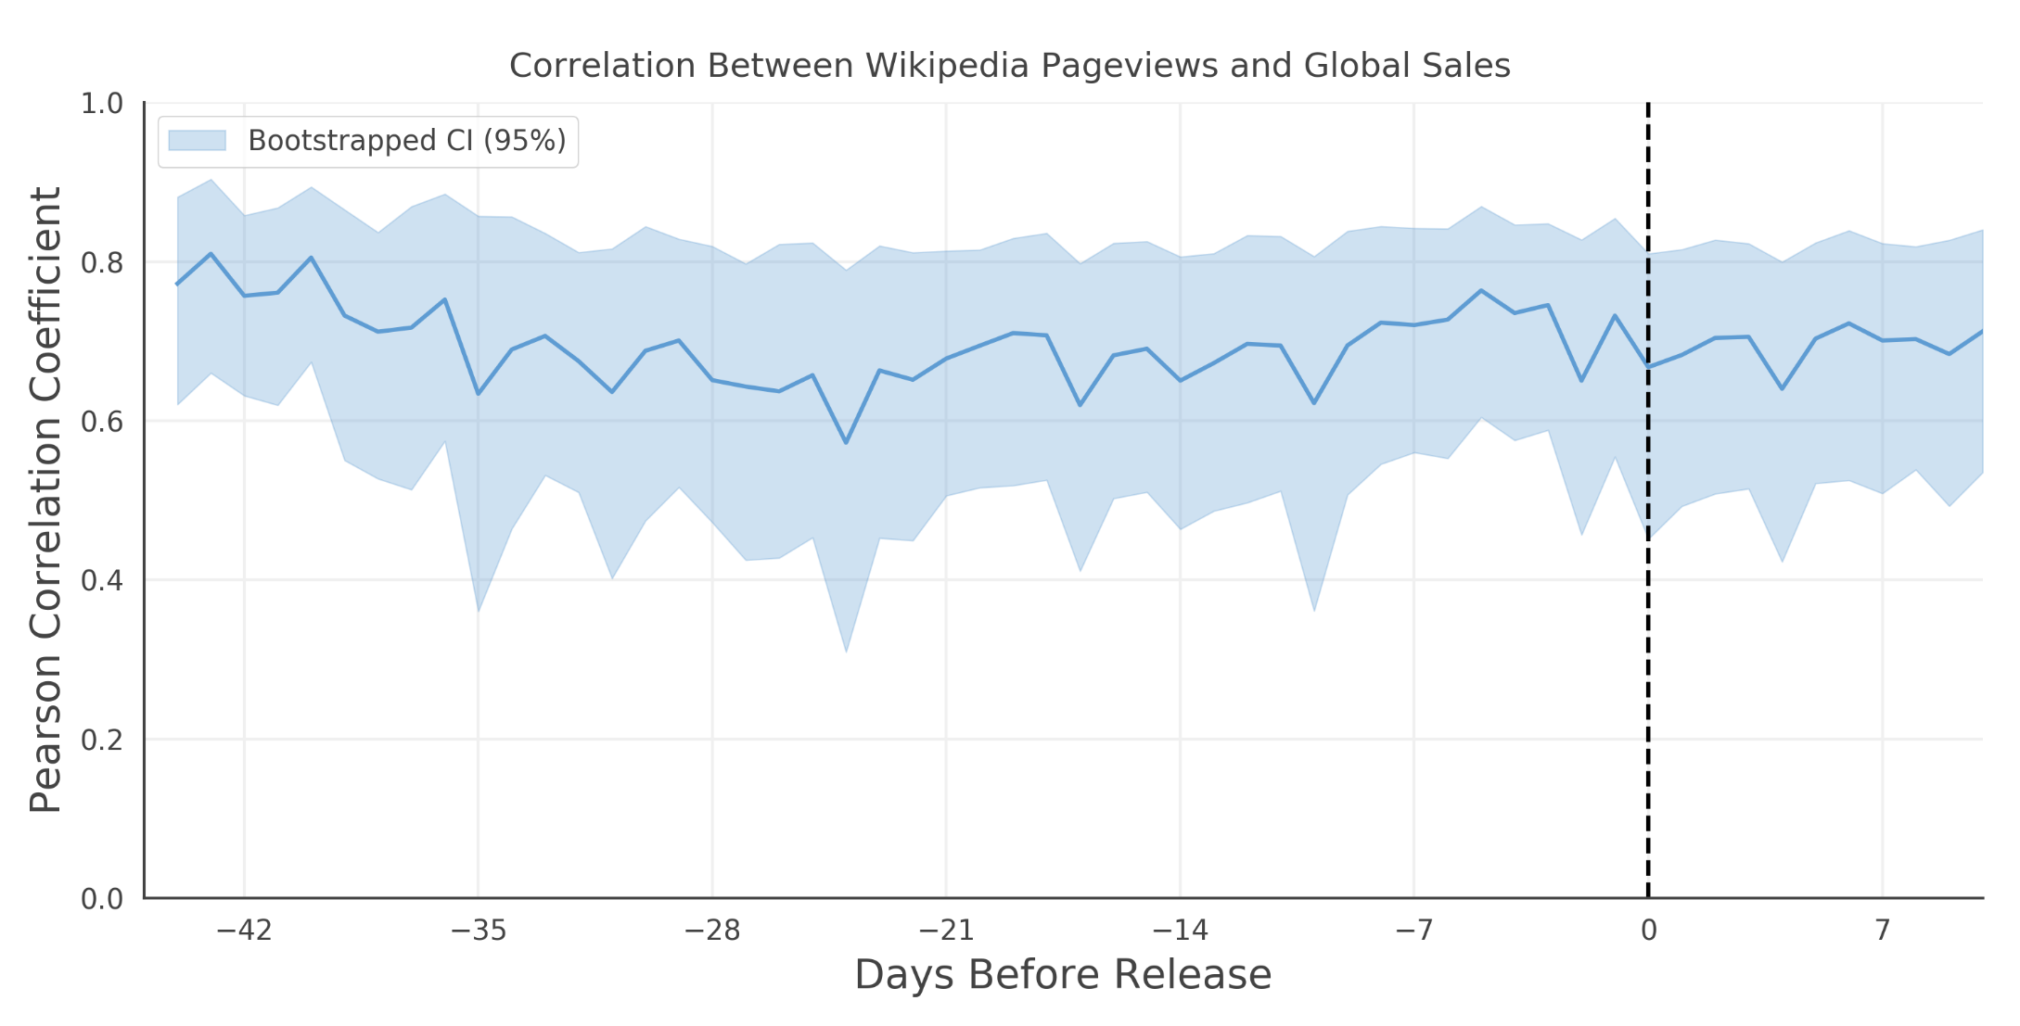
Video Game Sales
*Note: Coefficient range is from -1 (strongest negative correlation) to 1 (strongest positive correlation)
Correlation between Wikipedia pageviews and video game sales remains stable throughout pre-release window

Slide 18
Appendix

Slide 19
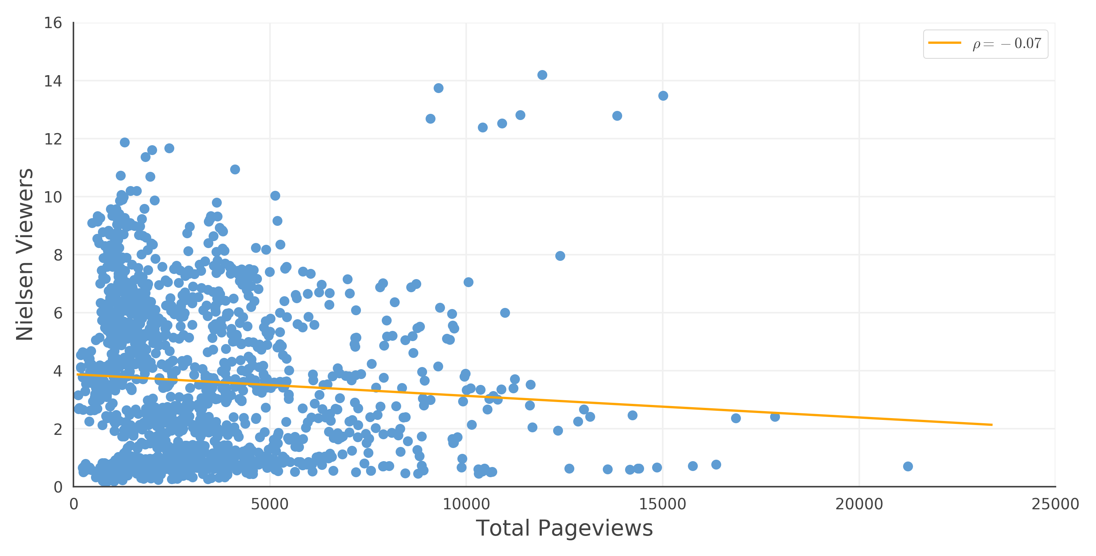
TV Viewership: Nielsen Viewer Score
*Note: Each scatter point represents 1 episode
*Note: Pageviews extracted 3-days before air date
Out of context, Wikipedia Pageviews do not have any correlation to TV episode viewership

Slide 20
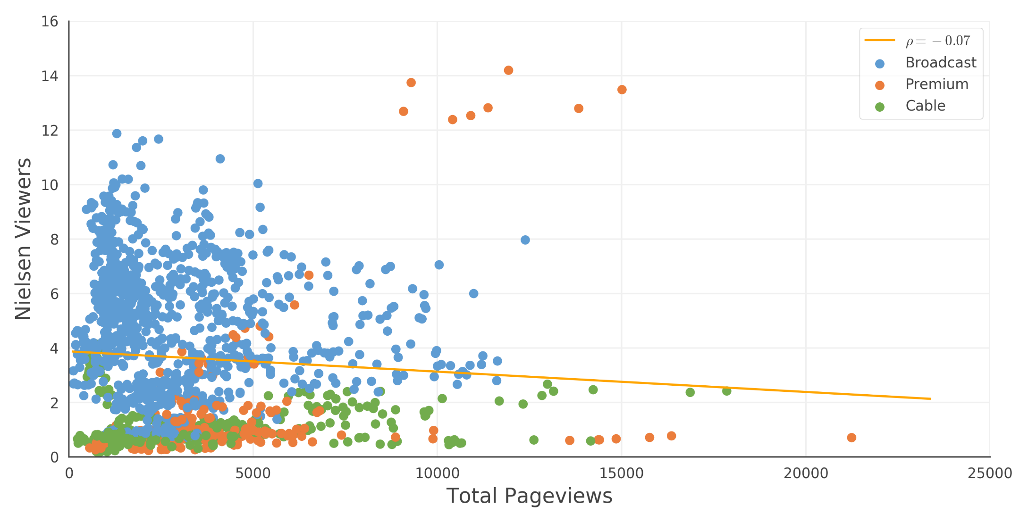
TV Viewership: Nielsen Viewer Score
*Note: Each scatter point represents 1 episode
*Note: Pageviews extracted 3-days before air date
However, there are baseline differences in viewership dependent on each show’s context

Slide 21
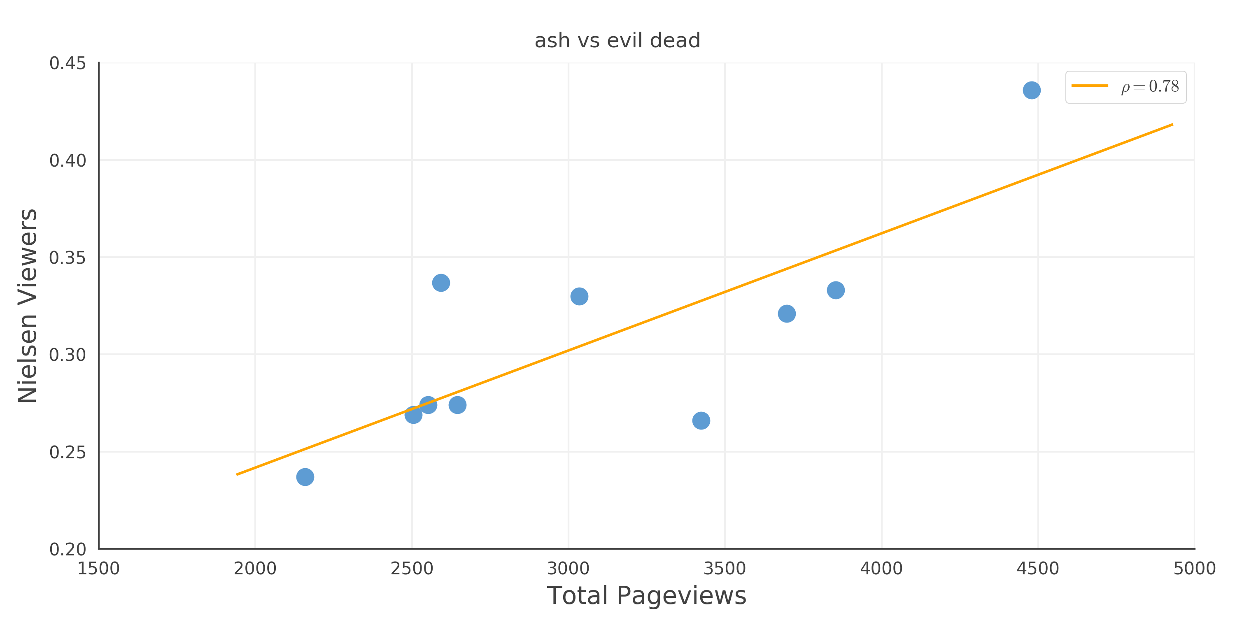
TV Viewership: Nielsen Viewer Score
*Note: Each scatter point represents 1 episode
*Note: Pageviews extracted 3-days before air date
Wikipedia pageviews for “Ash vs. Evil Dead” correlate well with viewership

Slide 22
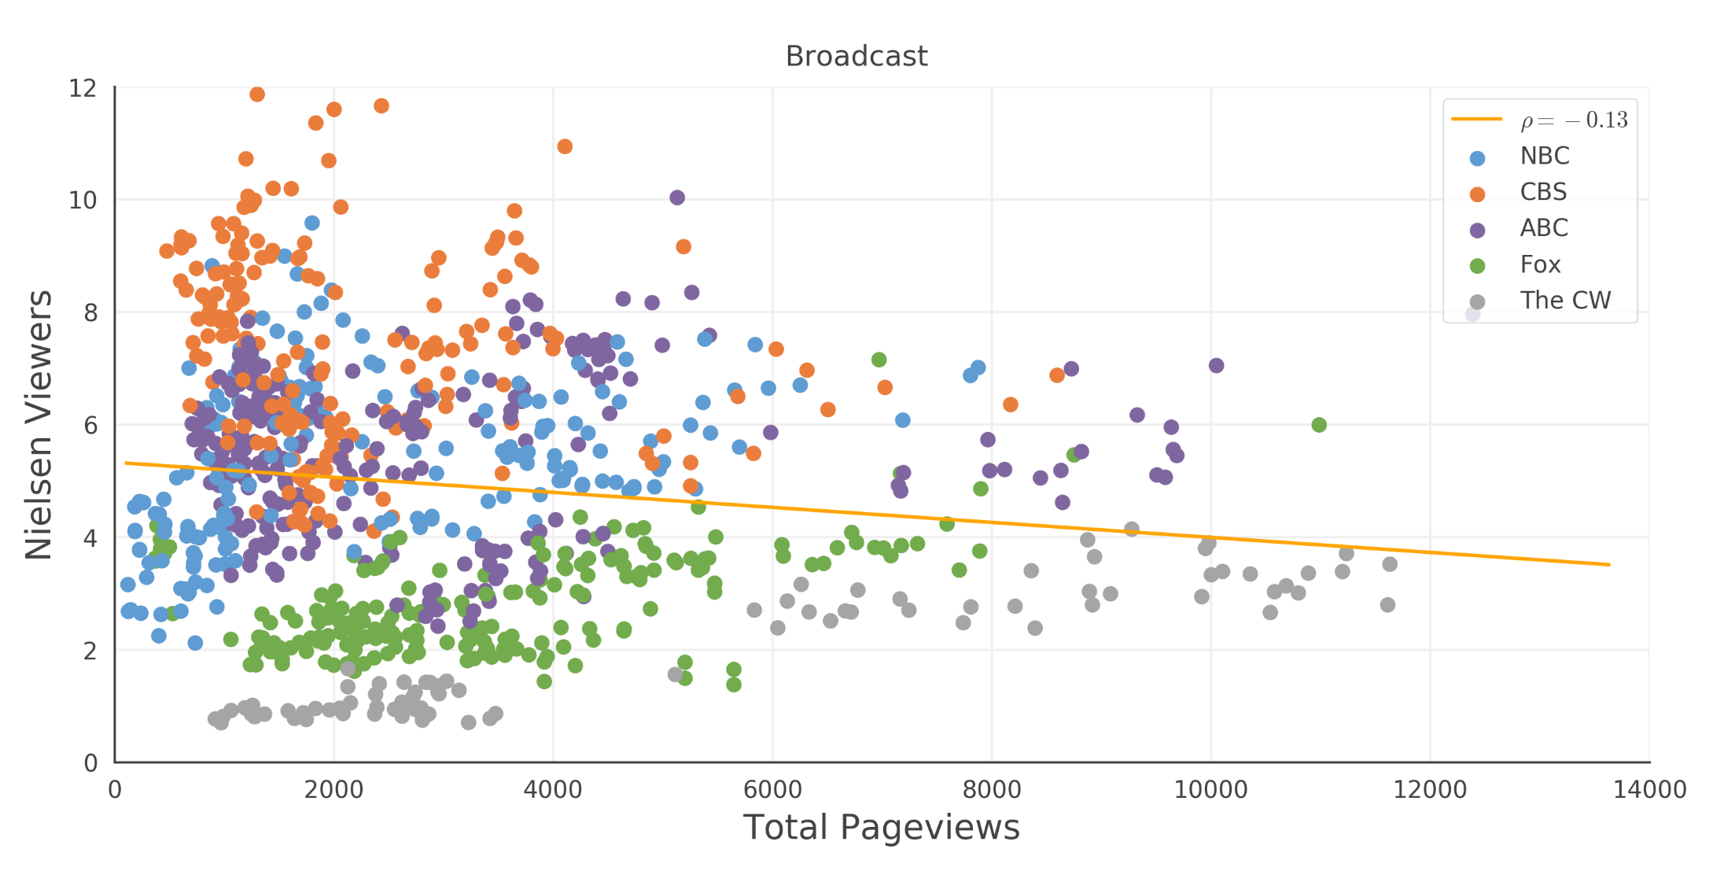
TV Viewership: Nielsen Viewer Score
*Note: Each scatter point represents 1 episode
*Note: Pageviews extracted 3-days before air date
“Network Type” does not explain variation in correlation by itself

Slide 23
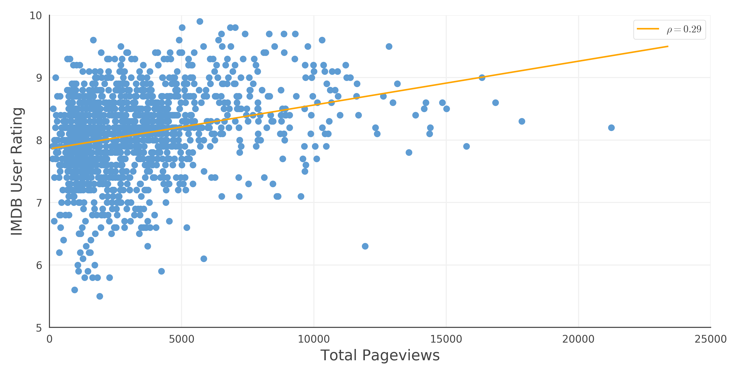
TV Viewership: IMDB User Rating
*Note: Each scatter point represents 1 episode
*Note: Pageviews extracted 3-days before air date
Wikipedia pageviews correlate weakly with TV Show Quality

Slide 24
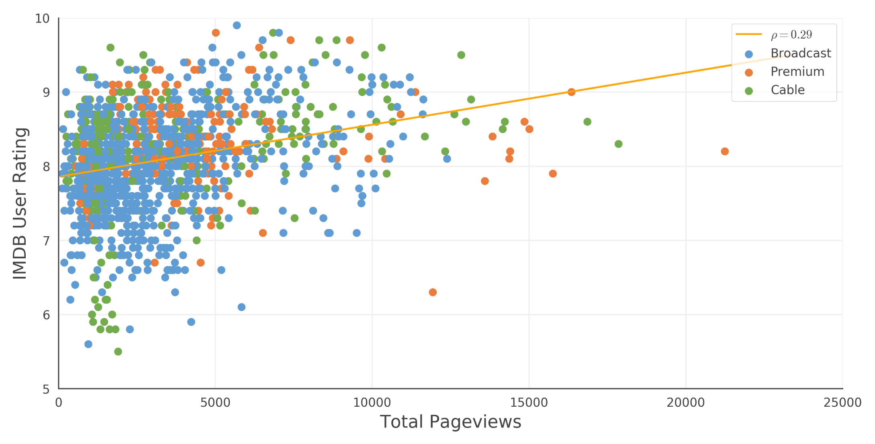
TV Viewership: IMDB User Rating
*Note: Each scatter point represents 1 episode
*Note: Pageviews extracted 3-days before air date
TV Show quality has minimal interaction with external factors

Slide 25
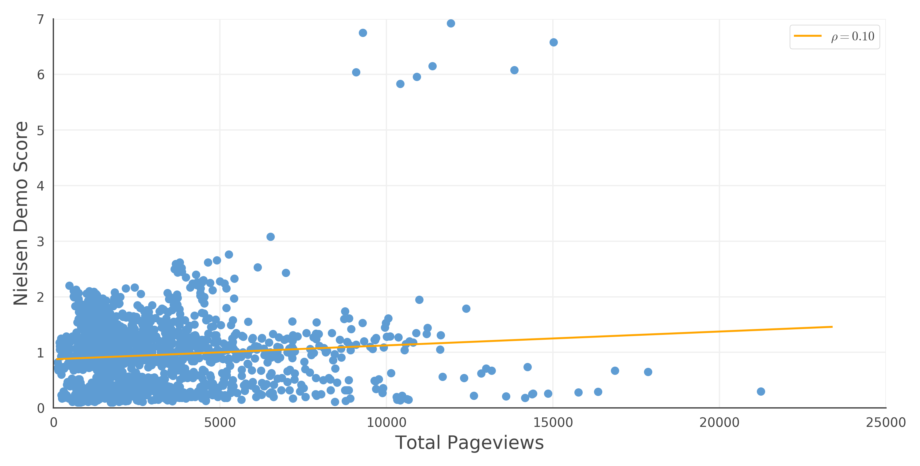
TV Viewership: Nielsen Demo
*Note: Each scatter point represents 1 episode
*Note: Pageviews extracted 3-days before air date
Out of context, Wikipedia Pageviews have a weak correlation with Nielsen Demo score

Slide 26
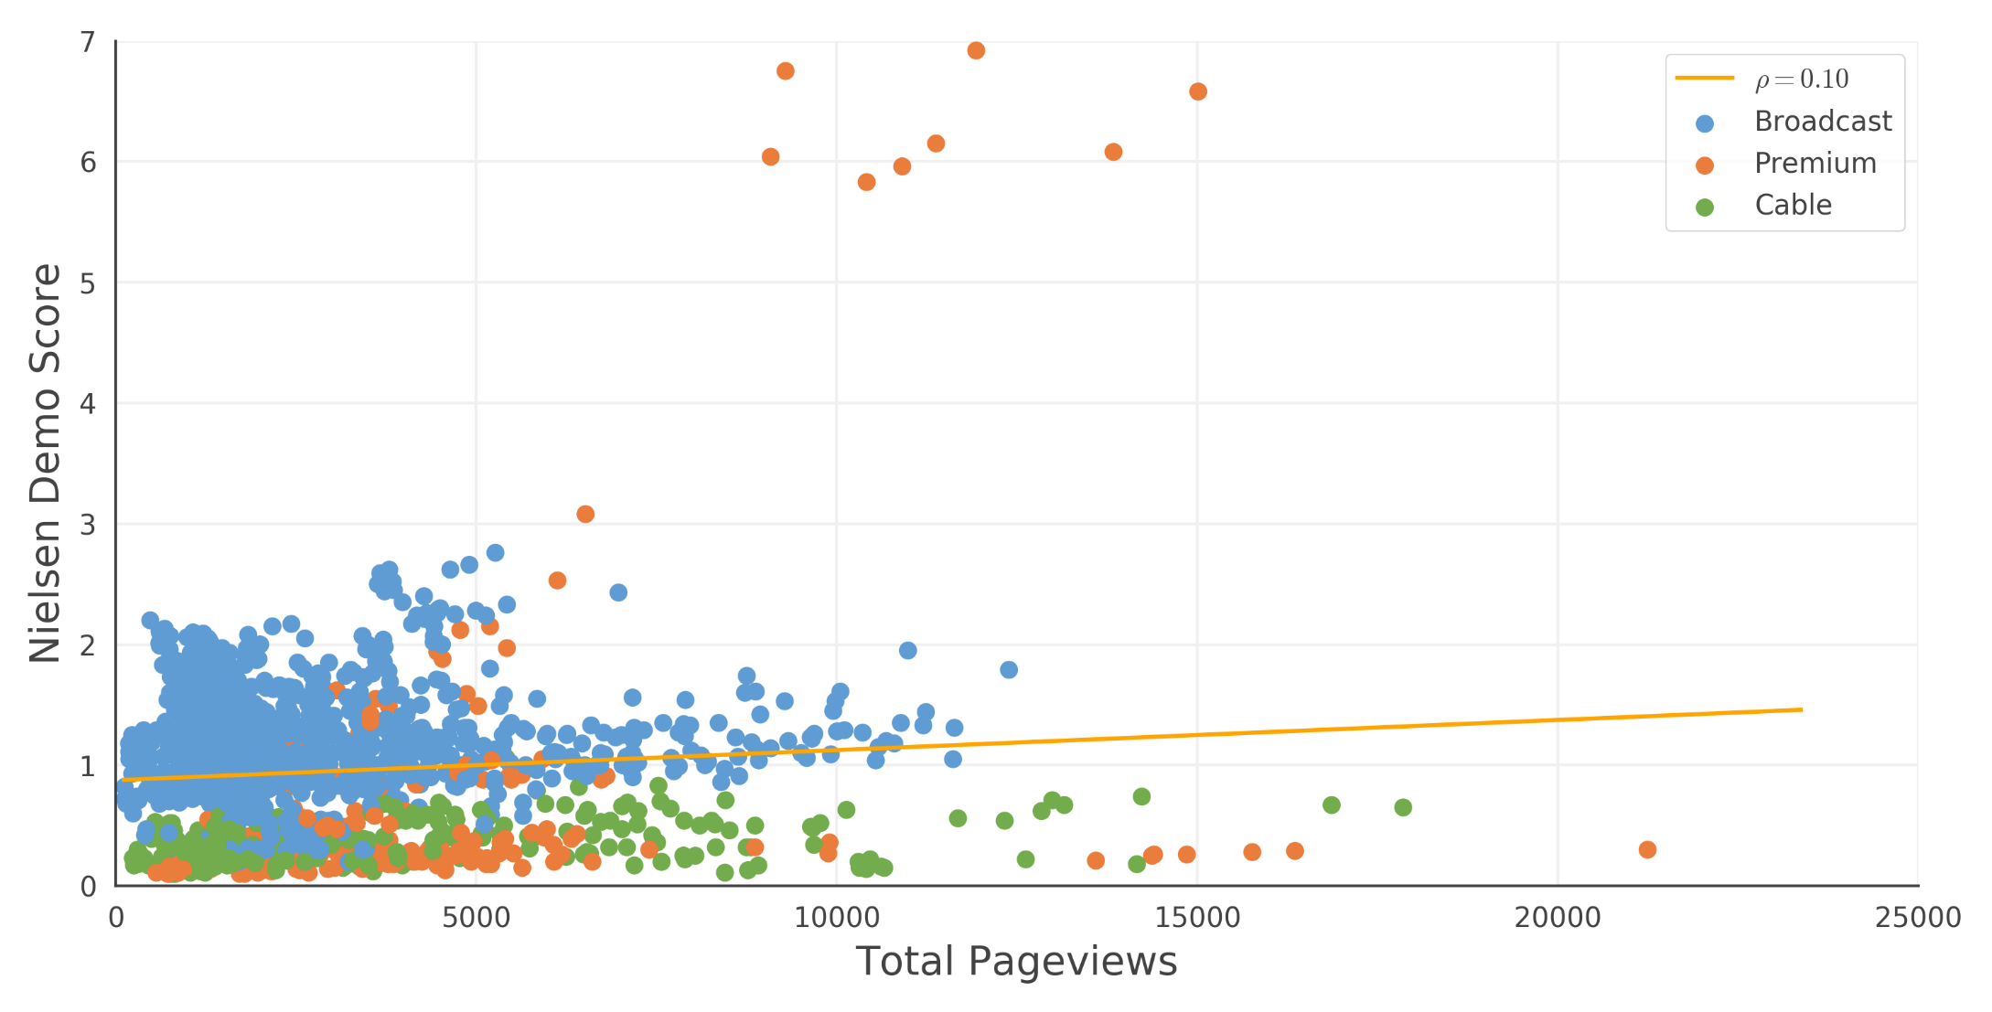
TV Viewership: Nielsen Demo
*Note: Each scatter point represents 1 episode
*Note: Pageviews extracted 3-days before air date
There exist significant differences in baseline Nielsen Demo scores dependent on context of each show

